Slide 1
Data Mining Seminar – Final presentation
Team 1
Munich, June 25, 2021

Slide 2







Hello, everybody!
Maurice Schweitzer
Management & Technology, M.Sc.
Maximilian Lange
Management & Technology, M.Sc.
Quazi Fahim Faisal Dhruba
Informatics, M.Sc.
Natalie Dach
Management & Technology, M.Sc.
Leon Schulz
Management & Technology, M.Sc.
Tawkir Ahmed Fakir
Data Engineering & Analytics, M.Sc.
Haowen Guan
Mathematics in Data Science, M.Sc.

Slide 3
Agenda
01
02
03
04
05
Challenges
Approach
First-stage models
Second-stage models
Results

Slide 4
Agenda
01
02
03
04
05
Challenges
Approach
First-stage models
Second-stage models
Results

Slide 5
We identified three main challenges
1
2
3
Evaluation by
public voting
Difficult testing, no direct measurement, strong impact on performance.
Provided data
is limited
Only few features given, small overlap of transactions and items, crucial data missing.
Combination of
different models
Deriving weights for different models.
When to trust which model?

Slide 6
Agenda
01
02
03
04
05
Challenges
Approach
First-stage models
Second-stage models
Results

Slide 7
We used data from seven different sources
Items.csv and transactions.csv
{
"itemID": "21310",
"title": "Princess Poppy: The Big Mix Up",
"author": "Janey Louise Jones",
...
}
Key (itemID)
ISBNDB.com
https://isbndb.com/
Google Books API
https://developers.google.com/books
{
"title": "Alice Im Wunderland: [...]",
"image": "https://images.isbndb.com/[...].jpg",
"date_published": "1973",
"authors": ["Carroll"],
"isbn": "3423071001"
...
}
{
"isbn": "1409048780",
"description": "A brand-new story in the best-selling […]",
"imageLinks.thumbnail": "http://books.google.com/[...]"
"page_count": "128",
"publishedDate": "2010-11-30",
...
}
API Query
API Query
UCSD, Kaggle, Data World (overall 5 datasets)
i.a. https://sites.google.com/eng.ucsd.edu/ucsdbookgraph/books
Amazon
https://www.amazon.de/
{
"isbn": "3423071001",
"image_url": "http://images.amazon.com/[...].jpg",
"country_code": "US",
"language_code": "eng",
"average_rating": "4.03",
...
}
{
„isbn": "21 1409048780 310"
}
Fuzzy Matching
Scrape, API, Fuzzy Matching
Notes:
ISBNDB: 27M
Google Books: 40M
Amazon: 33M
UCSD: 2.36M: https://sites.google.com/eng.ucsd.edu/ucsdbookgraph/books
Kaggle 10K + 10M inkl. 11k reviews: https://www.kaggle.com/jealousleopard/goodreadsbooks and https://www.kaggle.com/bahramjannesarr/goodreads-book-datasets-10m
Data World: 271K: https://data.world/divyanshj/users-books-dataset

Slide 8
Our approach consists of two stages
Stage 1
Stage 2
Data
Models
Data
Models
Items.csv
Items similarity
model
UCSD, Kaggle,
Data World
Cover images
Category
Clustering
model
Google Books
API
Rating
Amazon
web scrape
Amazon
model
ISBNDB API
Pages
Transactions.csv
Transactions
model
Recommendations
Price
Kaggle reviews

Slide 9
Agenda
01
02
03
04
05
Challenges
Approach
First-stage models
Second-stage models
Results

Slide 10
Items similarity model
Stage 1
Stage 2
Data
Models
Data
Models
Items.csv
Items similarity
model
UCSD, Kaggle,
Data World
Cover images
Category
Clustering
model
Google Books
API
Rating
Amazon
web scrape
Amazon
model
ISBNDB API
Pages
Transactions.csv
Transactions
model
Recommendations
Price
Kaggle reviews

Slide 11
The model calculates string similarity among features
Methodology
Limitations
Employ LCS String Matching
String similarity score multiplied by feature importance (weights)
Features: Title, Author, Main Topic, Publisher and Language
More importance to "Title" and "Author"
Final score = sum of feature scores
Detect Language
Books of same language prioritized
Imperfect Language Detection
Confidence score of detection model considered
Best weight combination not identified
Some recommendations demonstrate seemingly biased weightage of "Main Topic" and "Author"

Slide 12



We tried finding best weight combinations manually
Approach
Limitations
Required observing the results manually thus not scalable
Observations were very subjective based on the observer
Manually Select Weights
Judge Recommendations
Generate Recommendations

Slide 13





We created an optimizer based on transaction data
Find a way to remove human subjectivity and bias, and optimize weights in a scalable, automated fashion
Treat weights as Hyperparameters and do a Grid Search
Generate Recommendations
Score the recommendations based on how close they are
Compare with recommendations by the model based on transaction data

Slide 14
We decided on the following weights
Final weights
Consequence
Recommendations have at least 1 book in common with the top 5 recommendations from the transaction model
Eliminated some of the subjectivity
Logically explainable weights
'sim_title':
'sim_author':
'sim_lang':
'sim_publisher':
'sim_main_topic':
0.44
0.18
0.08
0.28
0.003

Slide 15
Clustering model
Stage 1
Stage 2
Data
Models
Data
Models
Items.csv
Items similarity
model
UCSD, Kaggle,
Data World
Cover images
Category
Clustering
model
Google Books
API
Rating
Amazon
web scrape
Amazon
model
ISBNDB API
Pages
Transactions.csv
Transactions
model
Recommendations
Price
Kaggle reviews

Slide 16
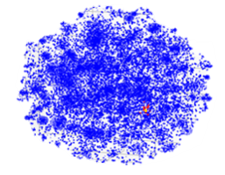
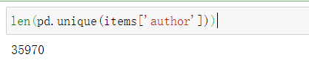
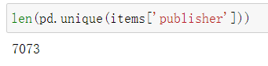
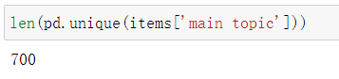
We recommend similar items to customer based on features of items and external data
Project the items into a vector space where items with similar properties should be close together.
Find a metric to capture the similarity between items and then recommend the 5 nearest items to a given item based on this metric
Challenge: combating high cardinality categorical features
Notes:
since customer might be interesed in buying books from same author or topic
Similar items should be are close together in the lower dimensional ‘feature space’ -> we need to find a meaningful low dimensional representation of the categorical data and than using the result k-NN as our recommendation

Slide 17
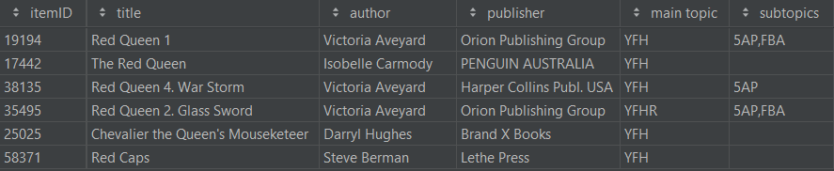
We combine SVD and k-NN in the model
Detailed implementation
Interim result after each step
Step 1: Encode the data
Tokenize item title to word sequence and reduce into word stems
One-hot encoding: categorical variables to numerical
High dimensional (77,000 x 80,000) and
Very sparse matrix (<0.1% of entries are non-zero)
Step 2: Dimensionality reduction
Computationally and mathematically necessary
Achieved by dropping columns or summarizing columns:
Remove rare title tokens and perform SVD
Only able to use 3000 summarized features (ca. 3% of encoded data) to capture 73% of total variance.
Step 3: Create recommendations
Find 5 nearst items in lower dimensional feature space
Notes:
since customer might be interesed in buying books from same author or topic
Similar items should be are close together in the lower dimensional ‘feature space’ -> we need to find a meaningful low dimensional representation of the categorical data and than using the result k-NN as our recommendation
Find a meaningful lower dimensional representation of the encoded data

Slide 18
Amazon model
Stage 1
Stage 2
Data
Models
Data
Models
Items.csv
Items similarity
model
UCSD, Kaggle,
Data World
Cover images
Category
Clustering
model
Google Books
API
Rating
Amazon
web scrape
Amazon
model
ISBNDB API
Pages
Transactions.csv
Transactions
model
Recommendations
Price
Kaggle reviews

Slide 19

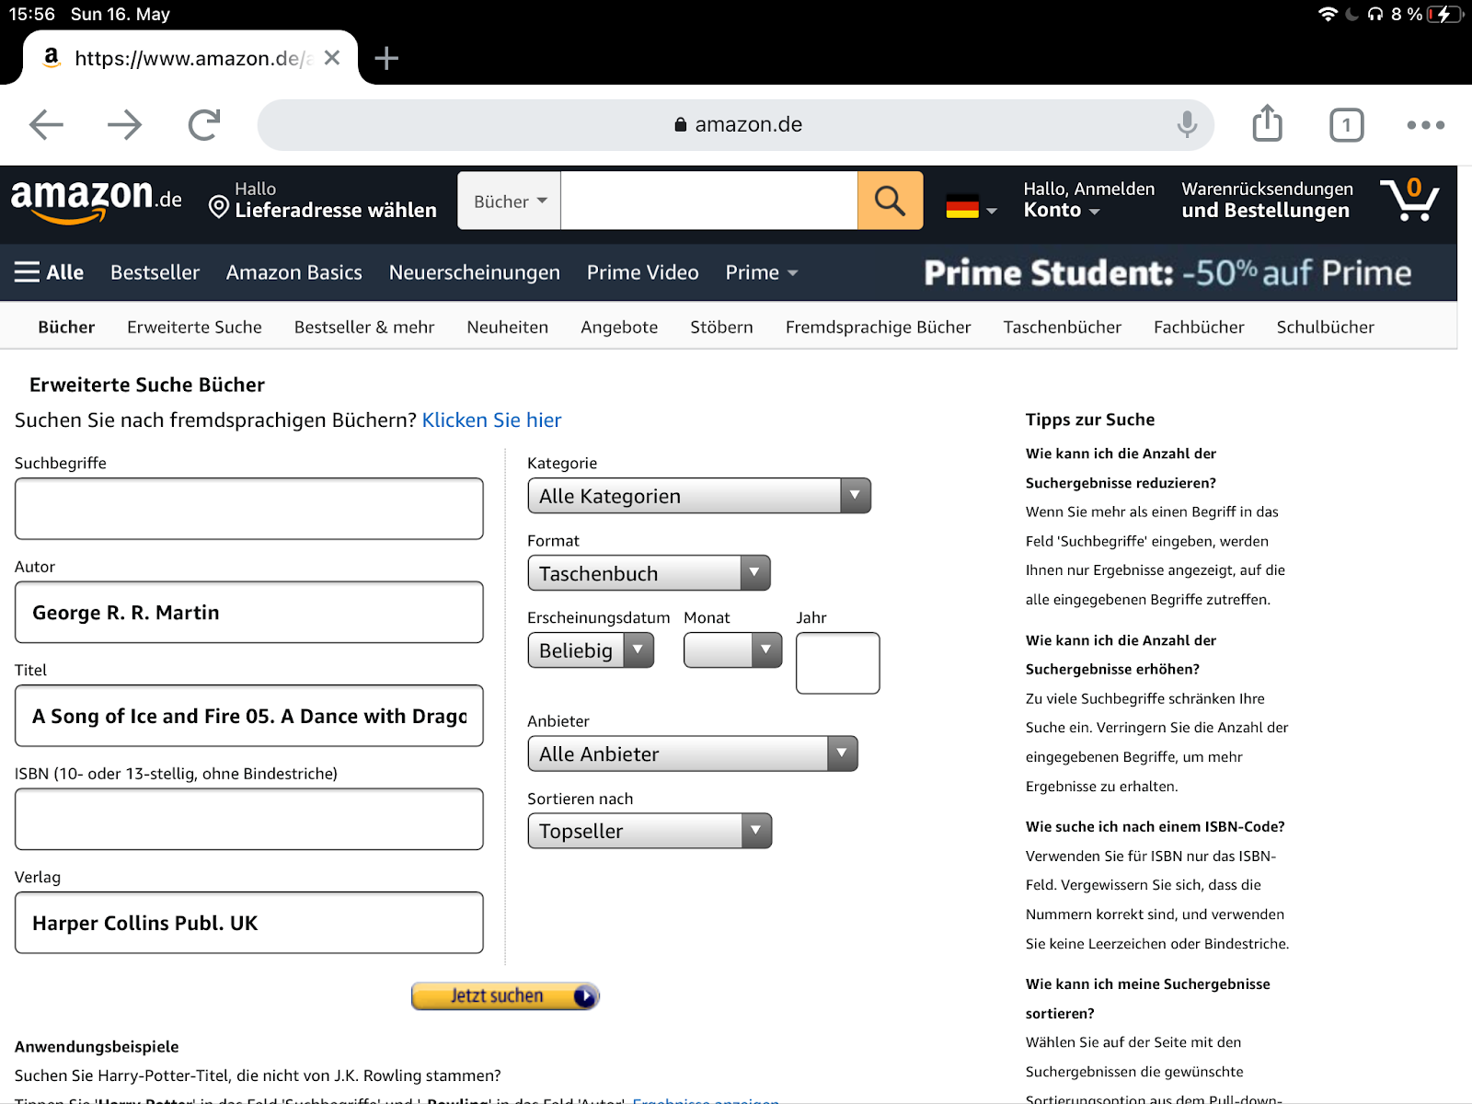

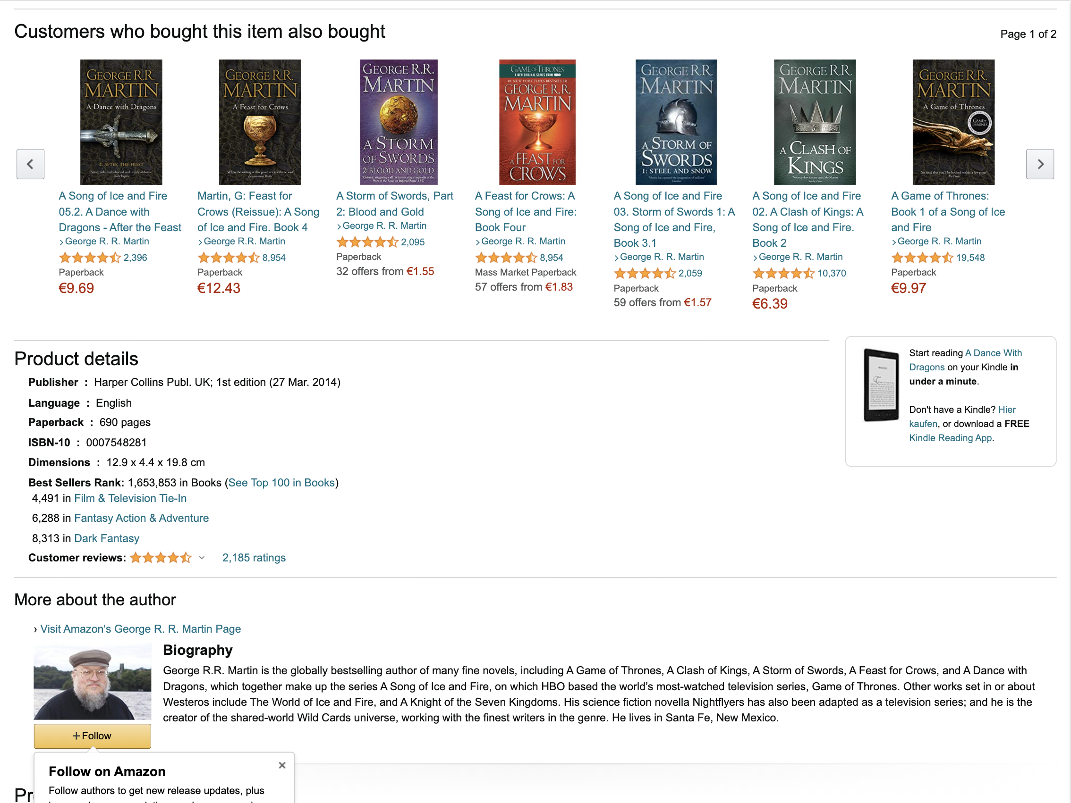



We scraped Amazon recommendations using JS Puppeteer
Step 1
Step 2
Step 3
Step 4
Choose recommendation source
Get URL for books in test set
Get ISBNs of recommendations
Get itemIDs for recommendations
Advanced book search
I. Match by ISBNs
Amazon search results
II. String matching by title, author & publisher

Slide 20
Amazon recommendations are scarce but of high quality
Approach
Strengths and weaknesses
Data
Recommendations missing for >50% of books
441 books with ≥ 1 recommendations
290 books with ≥ 5 recommendations
Only 30% of books with 5 recommendations
Model
Top 5 Amazon
recommendations
High quality of available recommendations

Slide 21
Transactions model
Stage 1
Stage 2
Data
Models
Data
Models
Items.csv
Items similarity
model
UCSD, Kaggle,
Data World
Cover images
Category
Clustering
model
Google Books
API
Rating
Amazon
web scrape
Amazon
model
ISBNDB API
Pages
Transactions.csv
Transactions
model
Recommendations
Price
Kaggle reviews

Slide 22
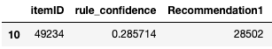
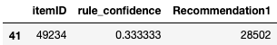
We leverage user data using two models
use transaction and external ratings data to identify items that are ordered or rated positively together
Data Input
Models
Transaction Data
Appriori
$$weigh{tappri}_{i}=conforder_{i}∗0.55+confbasket_{i}∗0.35+confclick_{i}∗0.1$$
Itempairs
External user ratings
$$weigh{tpairs}_{i}=occorder_{i}∗0.4+occrating_{i}∗0.3+occbasket_{i}∗0.2+occclick_{i}∗0.1$$

Slide 23

Sparce data leads to sparce results
Combine both models
Limitations and Extension
Bad Data Basis
In many cases couldn’t find 5 recommendations with this approach
$$weight_{i}=norm_{minmax}(weightpairs_{i}+\left(1+weightappri_{i}\right))$$
Extended model to also look for recommendations of recommendations
recommendations for 308 items
~4.8 recommendations per item
weak connection

Slide 24
First stage model outcome
Stage 1
Stage 2
Data
Models
Data
Models
Items.csv
Items similarity
model
UCSD, Kaggle,
Data World
Cover images
Category
Clustering
model
Google Books
API
Rating
Amazon
web scrape
Amazon
model
ISBNDB API
Pages
Transactions.csv
Transactions
model
Recommendations
Price
Kaggle reviews

Slide 25
We combine four different models using ordered lists
Combine ordered list of recommendations from each model using weights
Combine all first stage models: Up to 5 recommendations per model in ordered list
$$weight_{i}=0.25∗amazon+0.25∗transaction+0.25∗similarity+0.25∗clustering$$

Slide 26
Our models complement eachother very well, but we needed human sanity checks
Statistics
Limitations and Adaptations
Model | itemsimilarity | clustering | amazon | transaction
#of items | 1000 | 1000 | 441 | 308
Avg. #rec. per item | 5 | 5 | 4 | 4.8
Performed manual sanity check
Rule-based solution
Deployed adapted version of fuzzy string matching
Filtered out 226 recommendations
Sources of recommendations
1. Only ~10% of recommendations from more than one source
2. On average ~12 recommendations per item

Slide 27
Agenda
01
02
03
04
05
Challenges
Approach
First-stage models
Second-stage models
Results

Slide 28
We use a 2nd stage approach to impact the ranking of our final recommendations
Zeit: 01:00
use a 2nd stage model to impact the ranking of the recommendations.
use features that are computationally intensive or have too many missing values to integrate it in the 1st stage stage
missing values can be easily ignored as we only need 5 good recommendations.
Level 2 Input
Level 2 Model
Structural similarity
Histogram Correlation
0.5
Cover
0.5
0.25
Clustered main topics
Category match (ext.)
Subtopics match
0.5
Category
0.3
0.25
0.2
Level 2 Score
1
Level 1 Score
Weighted avg. rating
Number of ratings
0.8
Rating
0.225
0.2
Difference page count
1
Pages
0.225
1
0.05
Final Score
Difference price
Price

Slide 29
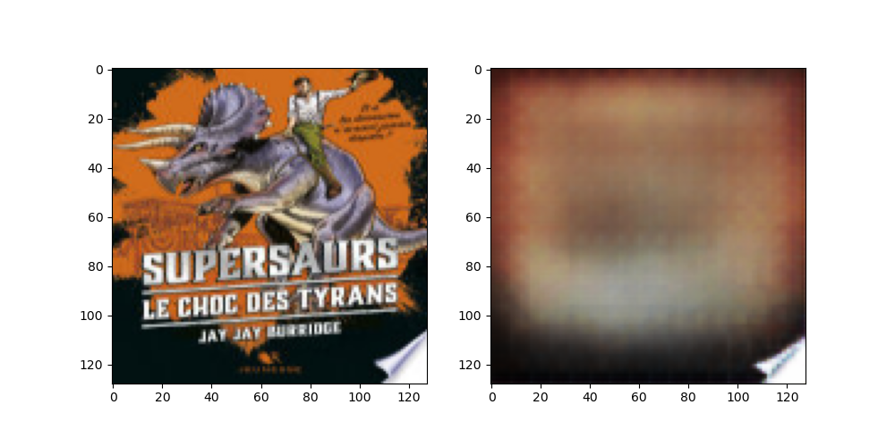
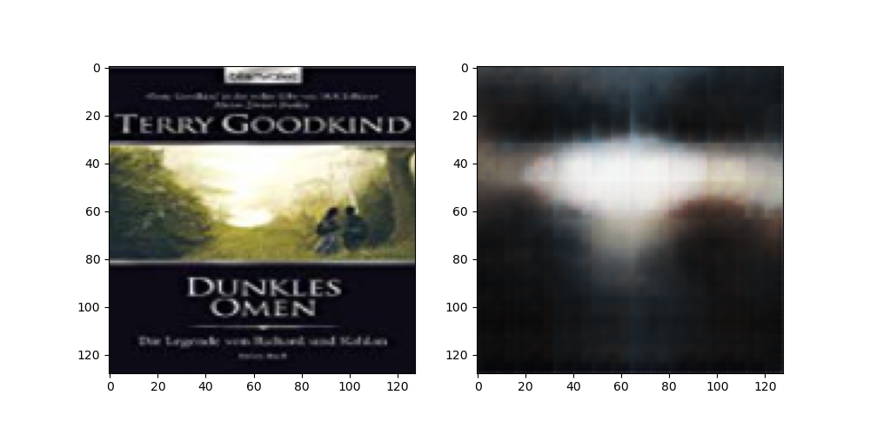
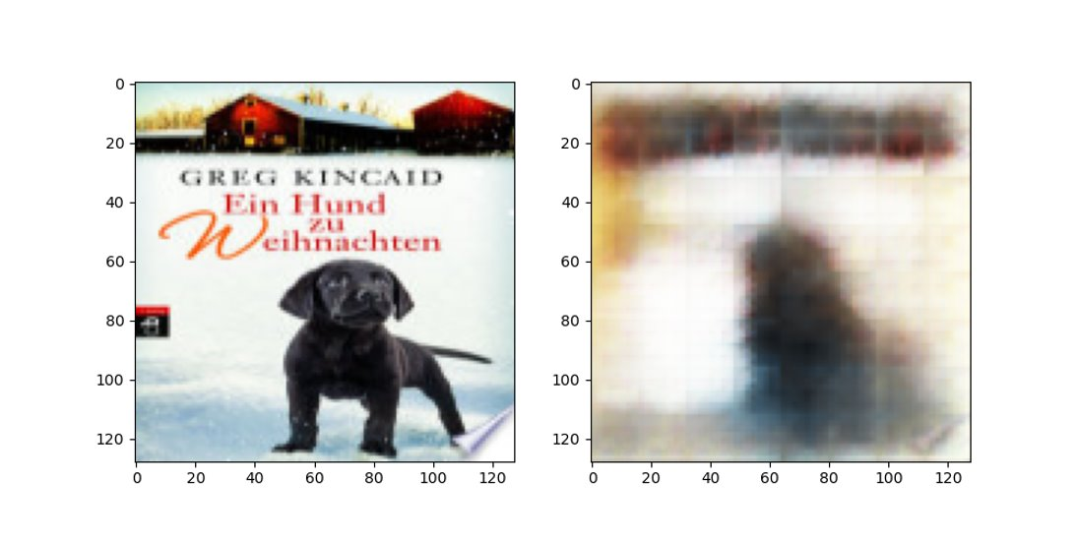
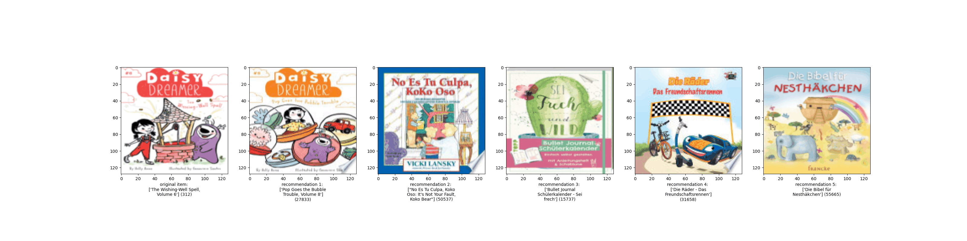
Variational autoencoders enabled us to consider visual resonance between input and recommended items
Original vs reconstructed cover images
Similar cover images found by VAE clustering algorithm
Notes:
since customer might be interesed in buying books from same author or topic
Similar items should be are close together in the lower dimensional ‘feature space’ -> we need to find a meaningful low dimensional representation of the categorical data and than using the result k-NN as our recommendation

Slide 30







Our model boosted proposals that were previously ignored
Zeit: 01:00
Results
Description
1st stage output
Only impacts the ranking of the recommendations created previously
Out of re-ranked books, we take out the
Top 5
Books that were not considered previously are now taken into account
2nd stage output
Limitations
Many missing values in external data
Rely on a few features only

Slide 31
Agenda
01
02
03
04
05
Challenges
Approach
First-stage models
Second-stage models
Results

Slide 32












Our model performs well in most cases, but seems limited for a particular group of books
Zeit: 01:00
Performance
Examples
Our model performs great for
Books that are part of a series
Books by authors that wrote many similar books
Books of a specific subject area for which there are many alternatives
Children’s Books

Slide 33












Our model performs well in most cases, but seems limited for a particular group of books
Zeit: 01:00
Performance
Examples
Our model seems limited for
Books where the title gives misleading conclusions
Books of rare languages (mostly French)
French
English
English
German
English
English

Slide 34
We successfully tackled all three challenges
1
Evaluation by public voting
Manual sanity checks to discover obvious problems that need to be tackled in our models
2
Provided data is limited
External data sources such as Google Books, Goodreads, etc.
Scraping Amazon for recommendations
Downloading book covers
3
Combination of
different models
Combining with different approaches
Apply a level 2 approach to re-rank the recommendations
Only 5 good recommendations are needed

Slide 35

We are looking forward to your questions!

Slide 36
Backup

Slide 37
External data - methodology
Find match
for title
Fuzzy String Matching:
Search for fuzzy match
via title
API Query:
Top 1 search result via title
1
Calculate confidence
for title
Fuzzy String Matching
row by row
2
Calculate confidence
for author and publisher
Fuzzy String Matching row by row
3
Apply filter rule and
keep best match
confTitle >= 45 AND confAuthor >= 45
OR
confTitle >= 95 AND (confAuthor >= 30 OR author == 'Unknown')
4
Notes:
Match for 87% of the items (68,678), so about 9,656 items did not find any match.
Google: 59%
ISBNDB: 29%
Exeternal data / fuzzy matching: 11%
89 of the items in the evaluation set did not find a match.

